Slide 1

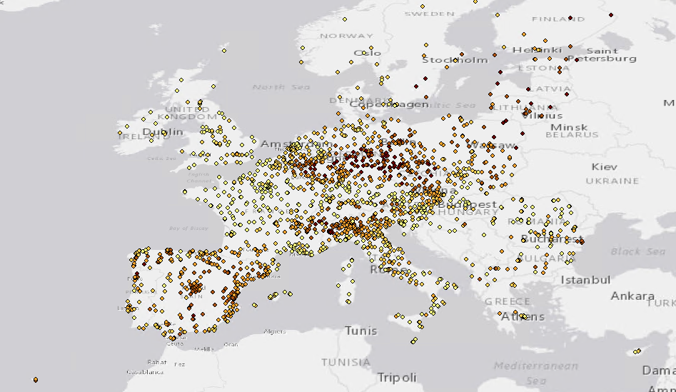

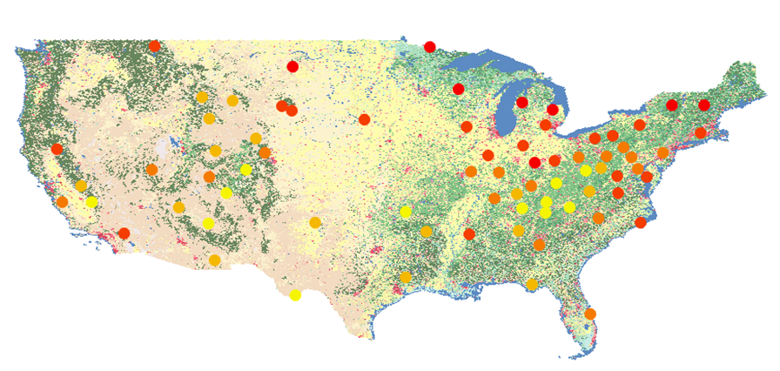
Evaluation of global IASI-GOME2 observations of lowermost tropospheric ozone as a predictor of ground-level ozone concentration
Hantao Wang, Juan Cuesta
Advised by Dr. Jason West
Gillings School of Global Public Health

Slide 2
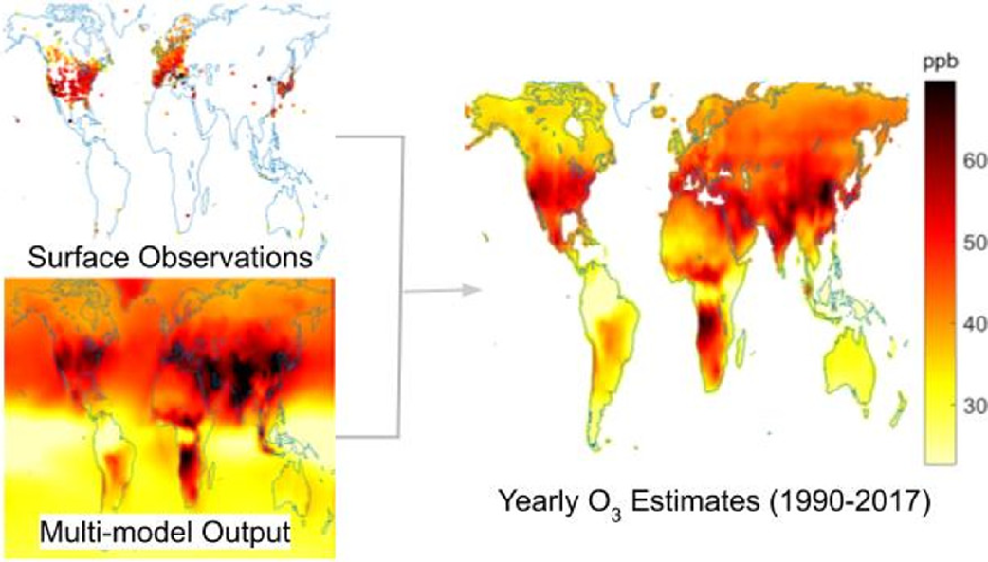
Data fusion (previous work)
To support the Global Burden of Disease 2019 (GBD2019) study, our group generated annual fine-resolution estimates of global surface ozone from 1990 to 2017 by fusing data from observations and 9 global models.
DeLang et al,2021

Slide 3
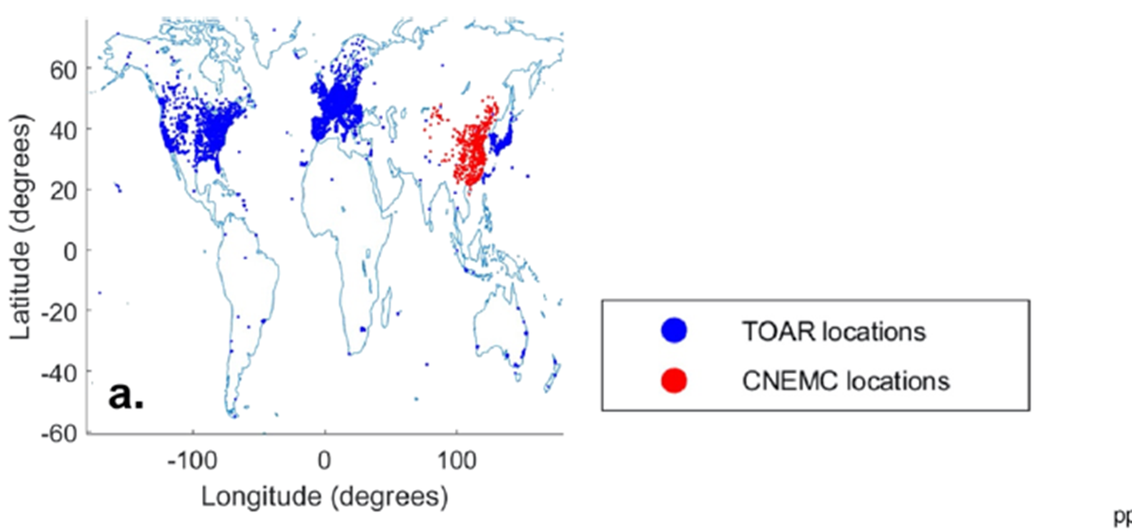
Background
  While the US, Europe, Japan and China created a large network, station observations of ozone elsewhere are extremely limited. ( Lu et al., 2018)
  Remote sensing techniques have been widely used to monitor the global distribution of tropospheric ozone. But ground-level ozone is difficult to detect.
  Recently, researchers have combined observations from satellites to infer ozone in the lower troposphere.
DeLang et al,2021

Slide 4
Motivation and Objective
The motivation is to use satellite observations to better understand ozone in regions with few ground monitors, and include it in data fusion of global ozone concentrations.
The main objective of this study is to evaluate satellite observations of ozone in the lowermost troposphere (0-3km) as predictors of ground-level ozone concentration.

Slide 5
Satellite Ozone observations from IASI+GOME2 database
Ground-level ozone observations
From Tropospheric Ozone Assessment Report (TOAR-I) database
Satellite: Meteorological Operational satellite (MetOp)
Sensor:
  Infrared atmospheric sounding interferometer (IASI): thermal infrared
  Global ozone monitoring experiment-2 (GOME2): ultraviolet
Spatial resolution: 1°*1°
Lower Tropospheric Ozone Product:
  Daily ozone vertical profiles 2016-present at 9:30 AM local time
  Surface to 3km
  Monthly averages of ozone mixing ratio in 2017
  ~60000 data points per month
Measurement sites:
  Almost 13,257 sites around the world
Ground-level ozone:
  1970-2017
  monthly averages of daily 8-hr maximum ozone concentration (MDA8) in 2017
  ~2600 data points per month
Cuesta et al,2018

Slide 6
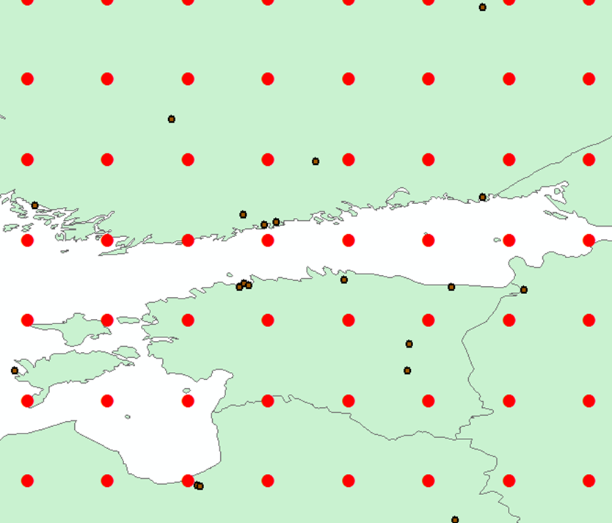

Comparing satellite with ground-level:
Ground monitors are point measurements compare to satellite observation which is an average over a large geographical region, and smoothes out spatial variation effects.
Satellite ozone retrievals are in the lowermost troposphere (0-3km).
Ground observations are monthly averages of MDA8, Satellite observations are monthly averages of ozone concentration at 9:30 am local time. For the purpose of the health study, we used monthly averages as the metric for the datasets.
Satellite observations (large red dots)
Ground observation sites(small black dots)

Slide 7
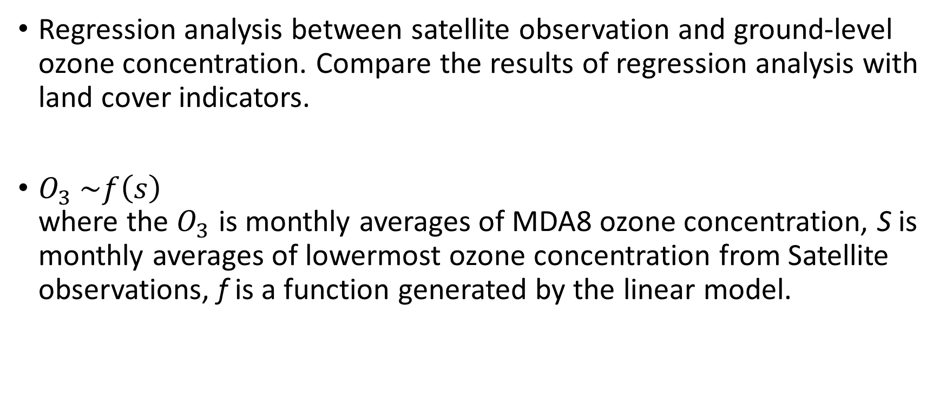
Method
Regression analysis between satellite observation and ground-level ozone concentration. Compare the results of regression analysis with land cover indicators.
$O_{3} \sim f\left(s\right)$
where the $O_{3}$ is monthly averages of MDA8 ozone concentration, S is monthly averages of lowermost ozone concentration from Satellite observations, f is a function generated by the linear model.

Slide 8
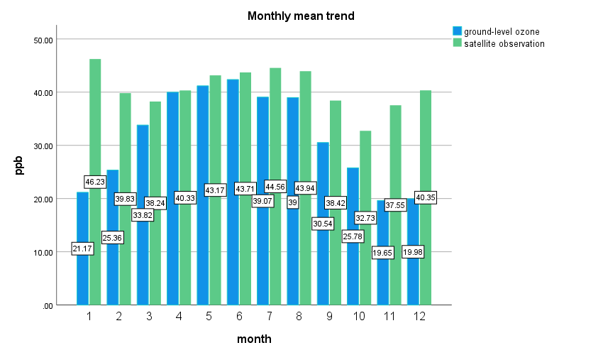
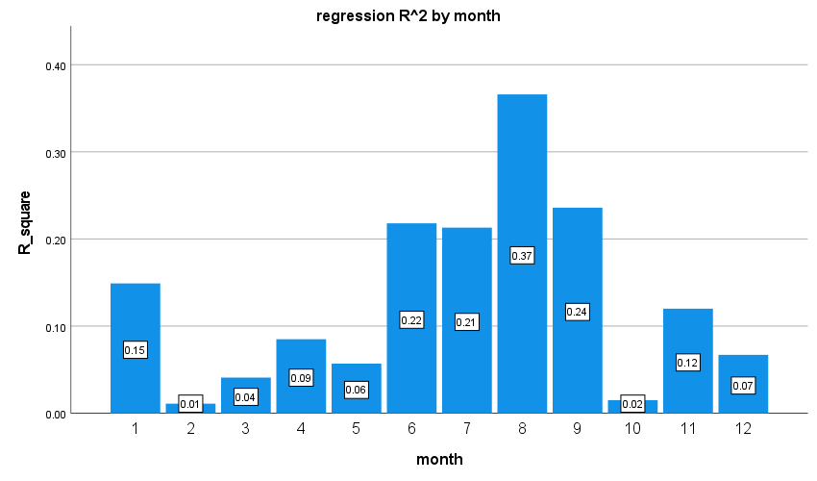
Mean trend
Regression
Annual mean of ground-level ozone is 32.1 ppb, and mean of corresponding satellite observations of lowermost tropospheric ozone is 40.5 ppb.
regression R_square for the whole 2017 year data is 0.069, satellite observation as predictor variable, ground-level ozone as dependent variable.

Slide 9
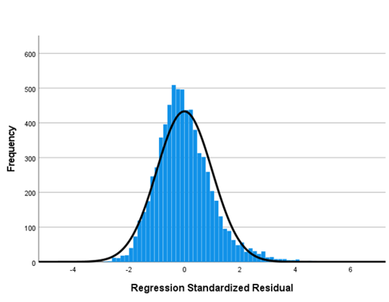
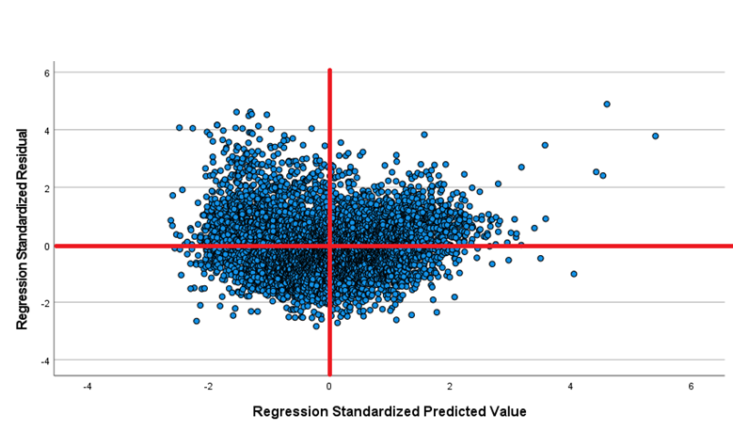
Residual analysis
Histogram of residual distribution
Scatterplot of residuals vs predicted values
The residual of the linear regression of the data for the whole year of 2017 was analyzed.

Slide 10
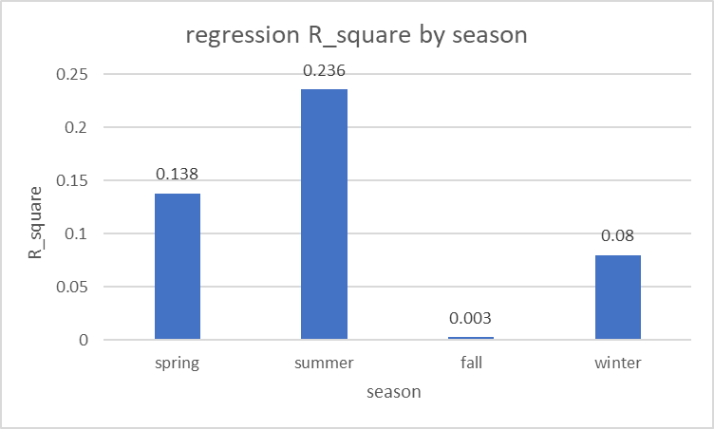
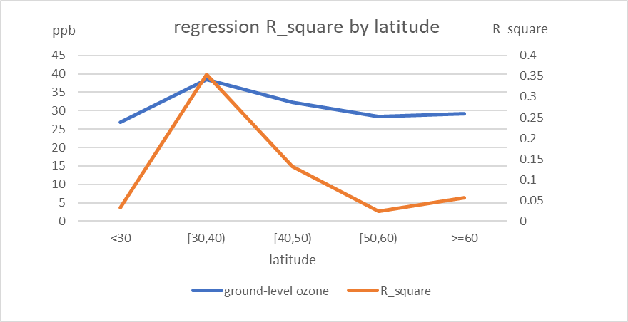
Temporal
Location
the correlation between satellite observations of lowermost tropospheric ozone and ground-level ozone is greatest in summer
R-square shares a same peak as the ozone ground-level concentration, a maximum at 30° to 40° latitude.
This may due to the Infrared energy emitted from surface at these time and area is relatively high or it may due to the high ozone concentration in these scenarios.

Slide 11
Different ground-level ozone concentrations
Ground-level ozone concentration | R_square from regression
0 to 0.25 quantile | 0.007
0.25 to 0.5 quantile | 0.006
0.5 to 0.75 quantile | 0.013
0.75 to 1 quantile | 0.176
Above or equal to the annual average (>=32.1 ppb) | 0.137
Below the annual average(<32.1 ppb) | 0.009
All data for 2017 year | 0.069
correlation between ground-level ozone concentration and satellite data increases when ground-level ozone concentration rises

Slide 12
Results:
There is a relatively good correlation between ground-level ozone observations and satellite data from June to September(Summer) or in 30°-40° latitude area.
Better correlation between ground-level ozone and satellite observations in areas with higher ground-level ozone concentrations. Worse agreement in areas with lower ground-level ozone concentrations.
Although the R-squared of the linear regression of monthly means throughout the year 2017 is small (0.069), the regression model is a valid fit according to the residual analysis.

Slide 13
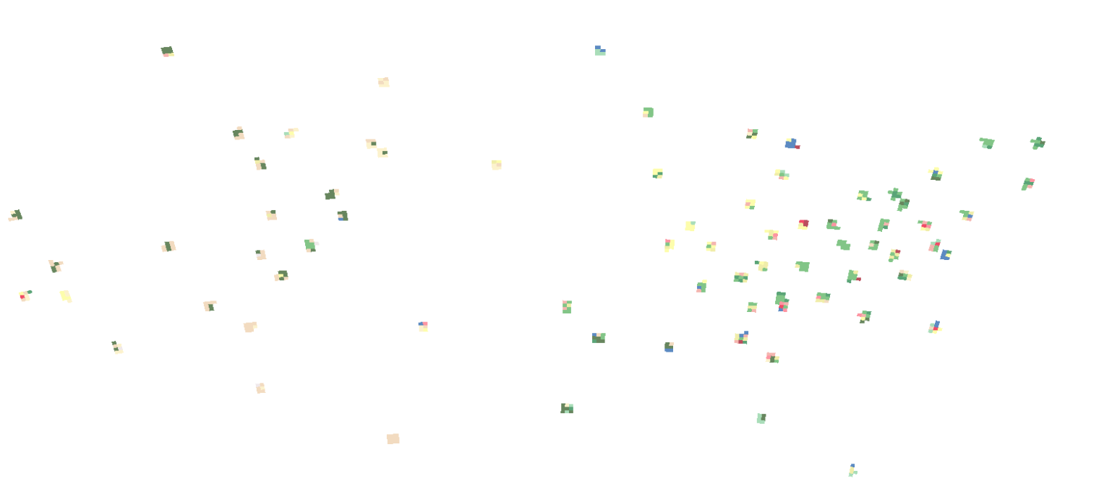

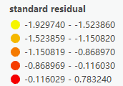
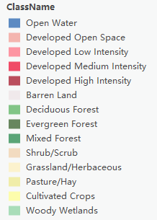

Land cover indicators
Mark total 85 Ozone Monitor Stations in Unite State.
Total 894 data points in 2017 year.
Find satellite gird contain each monitor.
Generate mask for each grid contain the monitor.
Records the number of pixel of landcover indicators within each grid
Total 14 kinds of landcover
National Land Cover Database (NLCD)

Slide 14
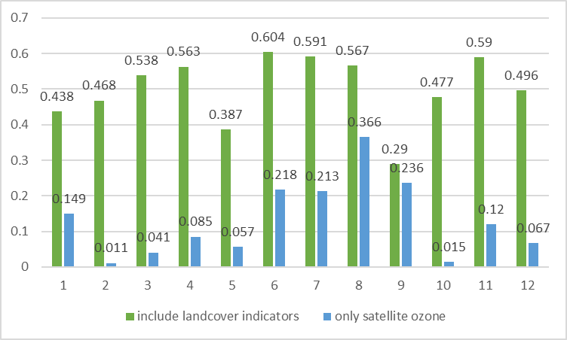
Regression include land cover indicators
Indicator Categories | Land cover
Water | Open water, snow/ice
Barren land | Developed space, Barren land
Wetland | Woody Wetlands
Crop | Pasture, Crops
Forest | Deciduous/Evergreen/Mixed Forest
Shrub | Shrub/Scrub, Grassland
predictors | R_square
satellite observation of ozone | 0.069
Include 6 land cover indicators | 0.245
Only 6 land cover indicators | 0.221
Only 1 land cover indicator(Water) | 0.046

Slide 15
Results
At the global scale throughout the year, satellite data and ground data have poor correlation, but show a better fitting after including the land cover indicators.

Slide 16
Conclusions
Satellite observation and ground-based observations of ozone show a strong correlation in summer and in the 30°-40° latitude interval.
The use of satellite ozone observation in combination with other data(like land cover) can greatly improve the correlation with variations of ground-level ozone.
The study suggests that when satellite data are included in data fusion, the spatial and temporal variability in performance with respect to ground data should be considered.

Slide 17
Next Steps
Use the TOAR-II database, which increases the number of sites to 19444 and includes data points from 1970 to 2021.
Evaluate observations of lower tropospheric ozone from the forthcoming TEMPO (Tropospheric Emissions: Monitoring of Pollution) instrument, relative to ground-level observations
Conduct data fusion using IASI+GOME2 observations of lower-tropospheric ozone to see if ground-level ozone predictions improve

Slide 18
Thank you! and any questions?

